Slide 1
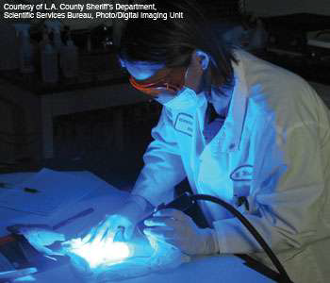
Introduction to Forensic Science and the Law
Forensic Science:
Uses principles of many sciences to aid
law enforcement officials and to uphold
the law.

Slide 2
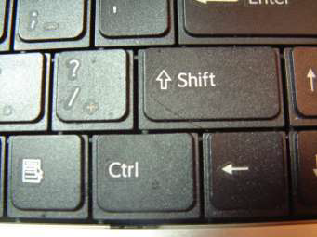
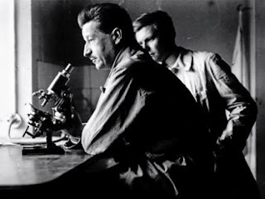
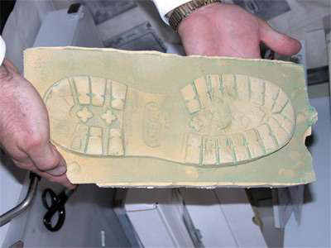
Edmund Locard
“Locard’s Exchange Principle:”
"Wherever he steps, whatever he touches, whatever he leaves, even unconsciously, will serve as a silent witness against him”.
Basic Principle of Forensic Science

Slide 3
Forensics and the Law
How an investigator
goes about collecting and
using such evidence is
where the law comes
into play….
“Bill of Rights”
U.S. Constitution

Slide 4
^{“Right of search and seizure}
^{regulated”}
* Was there probable
cause for the search?
* Was there an
invasion of privacy?
* Did the law officer
have a warrant?
*It is very important that evidence is collected lawfully, without an evasion of privacy, or with a search warrant, so it won’t be ruled inadmissible in court.*
Amendment
4th

Slide 5
4th Amendment…..continued
No Search Warrant
Needed If…
Consent: has EVER been given for the search.
Emergency: someone is in danger or is destroying evidence.
Arrest: Search of person/surroundings.
Plain View: if police there legally.
Reasonable Suspicion: if police believe they will find weapon/drugs on person/car.
To Issue a Search Warrant the Judge Must See…
Probable Cause:
proof a crime has occurred; AND
Evidence: proof criminal contraband will probably be found at the location or on the person linked to the crime.

Slide 6
“right to a fair and regulated prosecution”
*Capitol Case:
Grand jury must decide if there Is enough evidence before the indictment.
* Double Jeopardy:
It is imperative that all evidence be found before the trial—a citizen cannot be twice for the same crime.
5th
Amendment

Slide 7
“right to fair and regulated prosecution”
*Due Process:
Everyone is treated the
same in the court system.
*”Plead the 5th”:
An individual cannot be
forced to testify against
himself.
5th
Amendment

Slide 8
“Right to a speedy, fair, public trial”
6th
  *Speedy Trial:
--within 72 hours
arraignment held, defendant
is charged by judge, bail is
set, plea is entered.
--within 90-120 days
trial if defendant is in jail
imperative to find all
evidence ASAP..
delays help evidence
collection, but impairs eyewitness testimony.
\
Amendment

Slide 9
“Right to a speedy, fair, public trial”
  *Witnesses: can be
  subpoenaed to appear in
  court, for or against the defendant. Testimony is a form of evidence.
*Council: defendant has
the right to an attorney
(with or without $)
--attorney will closely
examine evidence
collection, handling, and
lab analysis for mistakes
to use for the defense.
* Double Jeopardy:
6th
Amendment

Slide 10
“Right to an impartial trial by jury”
* Jury of Peers
If the case value is more
than $1500, the trial has
a jury of one’s peers.
--some jurors have difficulty understanding
scientific evidence.
*Standardized Court
Any court system used
must be set up by the US
government.
7th
Amendment

Slide 11

Forensic Evidence in Court
“Innocent until Proven Guilty”
*How is evidence perceived
in court?
*What are the types of
evidence?
*How do we determine the
significance of evidence?
*How important is evidence
collection and handling?

Slide 12

All Evidence in Court must be Material and Probative
Material:
all evidence must relate to the current court case .
Probative:
all evidence must prove something to the court.

Slide 13
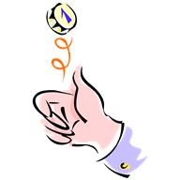
Probative Value
Probative Value:
The lower the probability of an event…the higher the probative value.
Probability:
Defines the odds that a certain event will occur.
(Probability of heads in a coin flip:
50 out of 100 flips)

Slide 14
Product Rule
OJ Simpson Case Crime Scene Blood Factors that Match OJ’s
Blood Factors | Frequency in Population | Decimal of Frequency
A | 26% | .26
EsD | 85% | .85
PGM 2+2- | 2% | .02
Calculate the overall frequency of occurrence in the population: .26 X .85 X .02 =.0044 (44%)
Less than 1 out of 200 people would be expected to have this combination of blood factors.

Slide 15

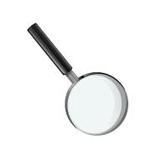
Types of Evidence in Court:
Direct Evidence:
evidence that establishes a fact.
Eyewitness/victim testimony
Confessions
Physical evidence found ON a person
Indirect Evidence: (circumstantial evidence)
Nearly all physical evidence
Requires that judge/jury makes inferences

Slide 16
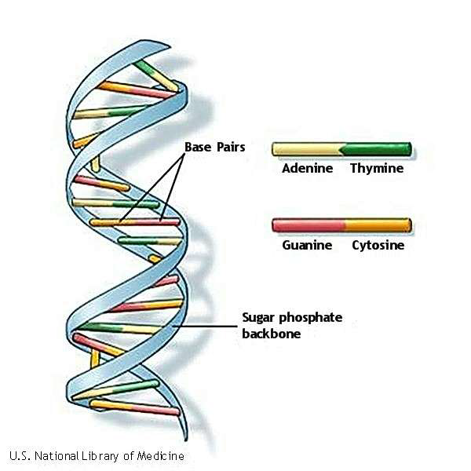
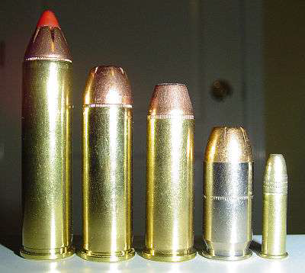
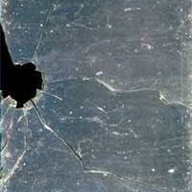
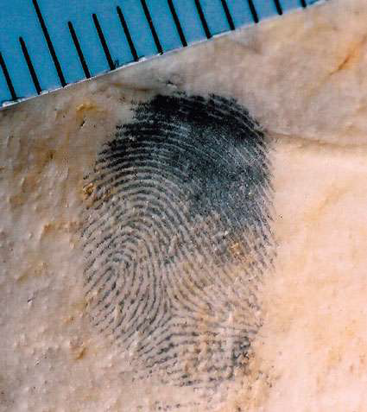
Types of Physical Evidence :
Individual Evidence: evidence
that can be linked with a unique
source with high probability.
Matching fingerprint minutea
Matching bullet striations
Matching DNA
Irregular edges of broken
object (glass/paper) that
fit together
Class Evidence: evidence that can
only be associated with a group,
not a single source (more linked class
evidence has higher probative value).

Slide 17
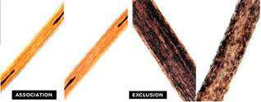
Influence of Direct/Indirect Evidence on the Court
Direct Evidence
(Eyewitness):
More subjective
Not as reliable
Hearsay not allowed
Eyewitness Problems:
Can be flawed questioning
Young/old age
Passage of time
Violence of incidence
Indirect Evidence
*More objective
*More reliable
*Police Officers Testimony :
(Direct Evidence) strengthens the probative value of physical evidence.

Slide 18
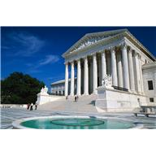
Influence of Direct/Indirect Evidence on the Court
Court Research:
differs on which type of evidence has a stronger impact on the jury.
Forensic Scientist:
should be aware of the persuasiveness of eyewitness testimony and not allow it to interfere with the analysis of physical evidence.

Slide 19
Court Admissibility of Evidence:
Court precedents determine the admissibility of scientific evidence and analytical results in court
Federal Rule of Evidence # 702
“Expert Testimony”
Hearsay only allowed by an expert with knowledge, skill, experience, training, and/or education on a scientific matter and if:
*the testimony is based on facts
*if the testimony is from reliable principles
and methods
*the witness has applied the methods reliably
to the facts of the case.

Slide 20
Court Admissibility of Evidence:
Court Precedents that determine the admissibility of scientific evidence and analytical results in court
Frye vs. US, 1923:
the questioned scientific/procedure
must be “generally accepted” by a majority of scientist.
Daughbert vs.
Merrill Dow:
*Can it be tested?
*Has the theory been peer reviewed?
*What is the potential rate of error?
*Are there standards of control?
*Does the theory have widespread acceptance?

Slide 21
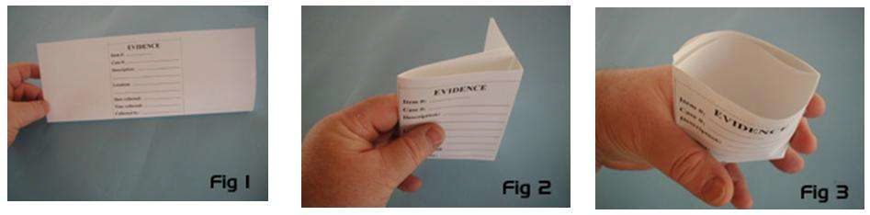
Court Significance of Procedures
In Evidence Collection/Analysis:
A systemic search for all evidence conducted.
All evidence collected.
Comparison type evidence collected.
Reference samples: for comparison.
Substrate controls: from surface close to collected evidence.
Proper packaging and separation of evidence is crucial (cross-contamination avoided).
Chain of Custody: written record of evidence possession.

Slide 22
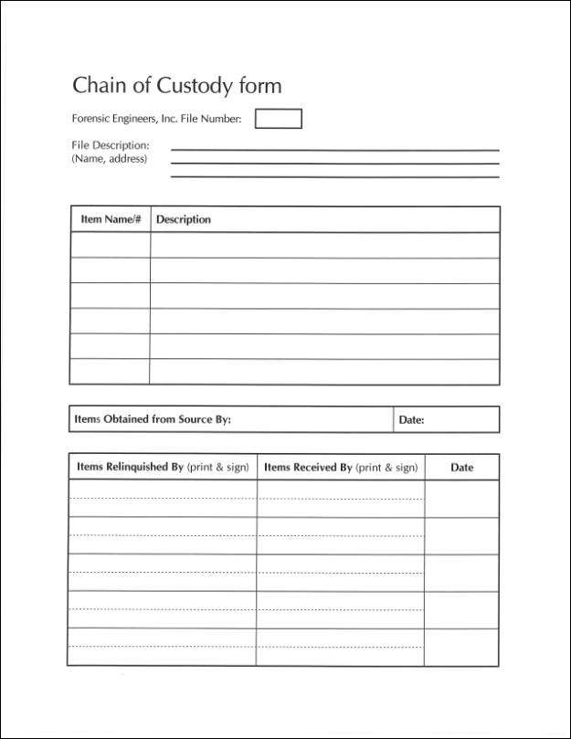
Chain of Custody:
Witnessed, written record of all individuals who have had evidence in their possession from the crime scene to the courtroom (who, when, what purpose for transfer)

Slide 23
Chain of Custody:
The item of evidence itself should be
identified, as well as the location, time, and collector.
The evidence container should be marked
for ID: with collector’s initials, location
where found, and date.
The chain of custody record is often kept as
as a form on the container/envelope.
If the evidence is turned over to another
for any reason (care/delivery), this transfer must be recorded immediately.
well as the location, time, and collector.

Slide 24
Chain of Custody (continued):
Every individual who possesses the evidence must record its’ acquisition/disposition and may be called to testify in court (from crime scene collection, delivery, detective, lab analysis, to courtroom).
Any samples of the evidence taken for testing, or any evidence changes, should be documented
To avoid confusion, the number of individuals involved and the chain of custody, should be kept to a minimum.
Failure to substantiate the chain of custody may
lead to questions on the evidence’s authenticity/integrity in the courtroom.

Slide 25
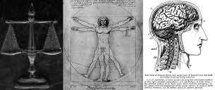
Responsibilities of the Forensic Scientist In/Out of the Courtroom
Ethics of a Forensic Scientist:
Examinations are done impartially, independently, objectively, and to completion, without financial gain.
Care should be taken in the treatment of samples and controls/standards used.
All results are based solely on the evidence (not on outside influences).
All conclusions should be communicated clearly to fellow law enforcement and to judges/juries/attorneys (expert witness).
All conclusions should be made honestly, and only in one’s field of expertise.
Attempts be made to reconcile.
Commitment to long term learning, and use of current/new testing procedures.

Slide 26
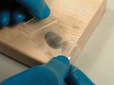
Responsibilities of the Forensic Scientist In/Out of the Courtroom
Forensic Scientists’ Duties:
Identify and collect all evidence from the crime scene, etc in a thorough, legal manner.
Preserve this evidence and handle proper procedures in handling (chain of custody).
Analyze, evaluate, compare this evidence.
Document and write these findings into a technical report.
Communicate these results clearly to law enforcement peers.
Be an “expert witness” to present technical evidence and conclusions effectively in a court of law.
Provide training to police officers/others involved in proper recognition, collection, and preservation of physical evidence.

Slide 27
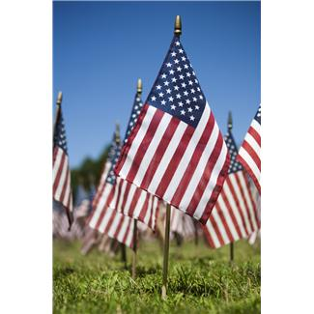
Above all, a forensic scientist should complete these responsibilities with the highest ethical standards, and the utmost regard for the United States legal system.

